Slide 1
SVM(Support Vector Machine).
SVM is a discriminative classifier that it is formerly designed by a separative hyperplane.
It is Representation of example as points in spaces that are map so that the points of different categories are separated by a gap as wide as possible.
It is suitable when the dimensions are more.
It is mostly used in classification problems.
Support Vectors are simply the coordinates of individual observation.
we perform classification by finding the hyper-plane that differentiates the two classes very well.

Slide 2
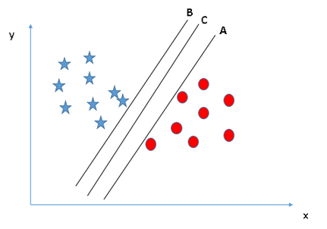
B and A-Support vector C-Hyperplane distance between B to A is called margin.

Slide 3
Steps to Implement SVM:
Loading the data
Exploring the data
Splitting the data
Generating the model
Model evaluation.

Slide 4
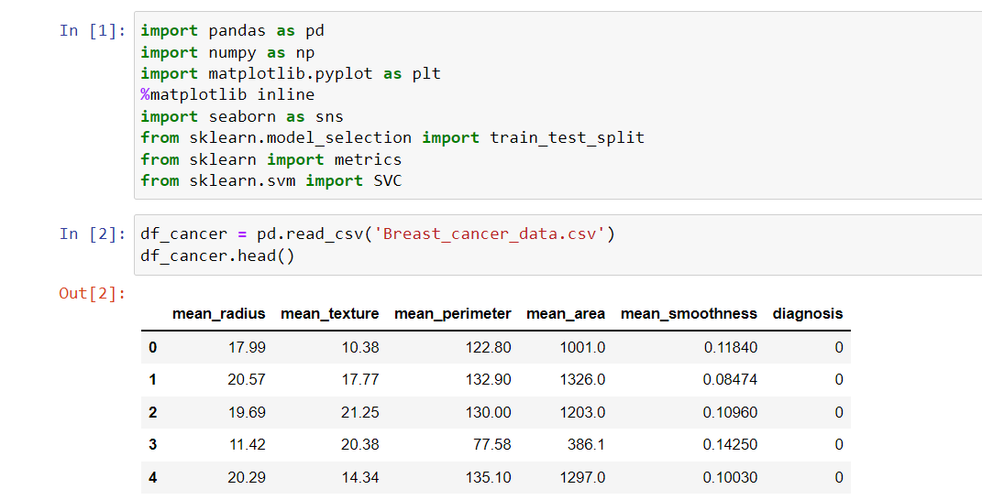
Program:

Slide 5
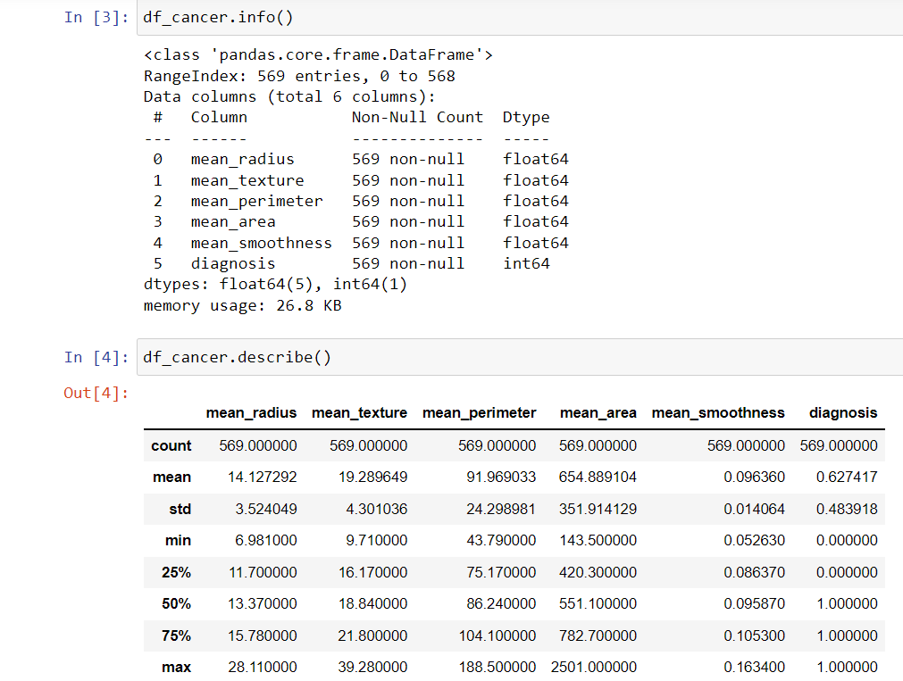

Slide 6
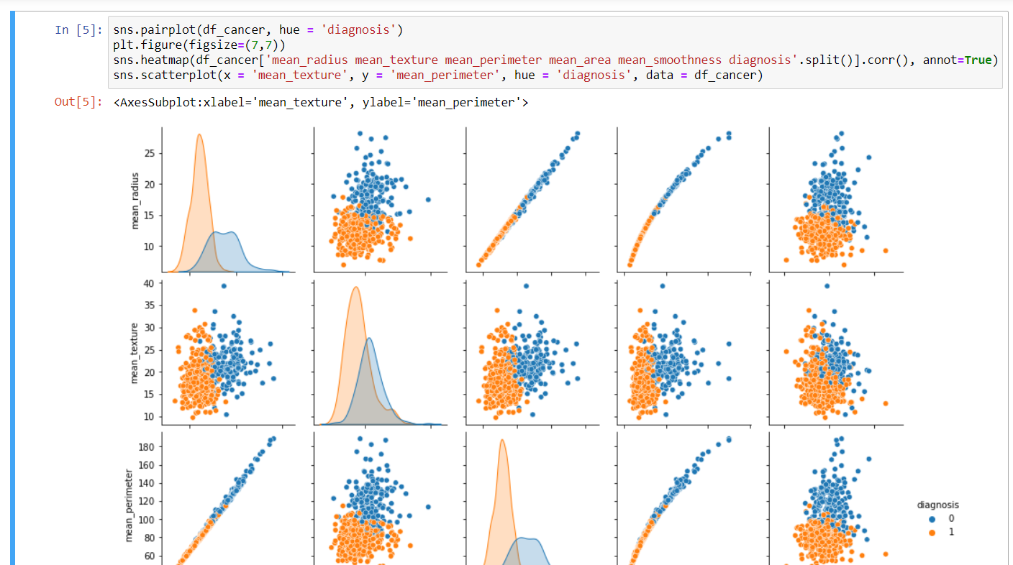

Slide 7
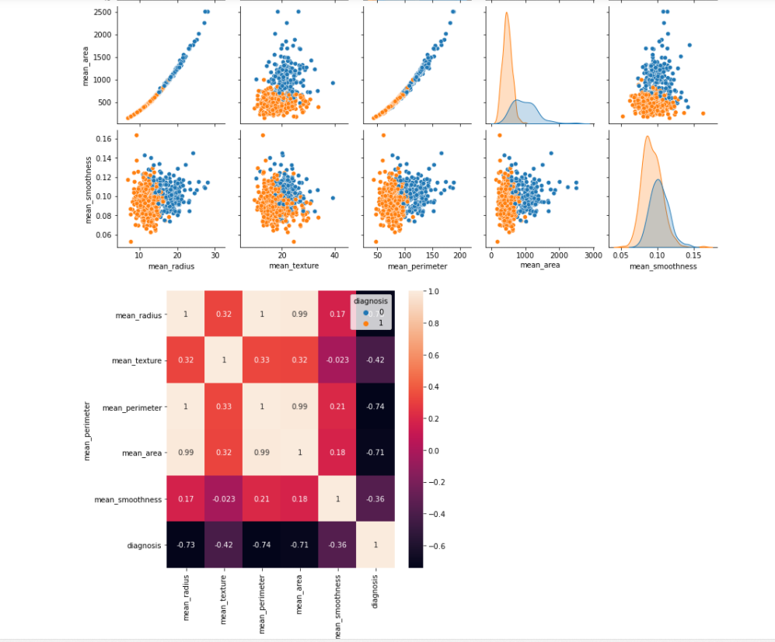

Slide 8
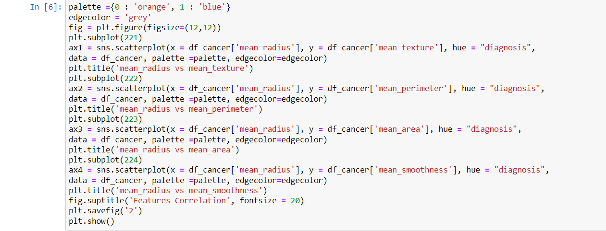

Slide 9
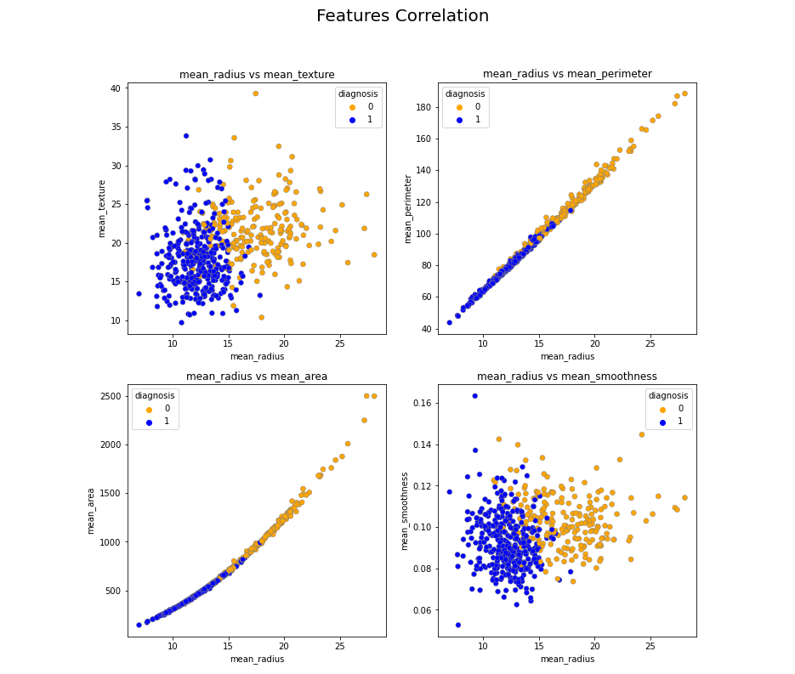

Slide 10
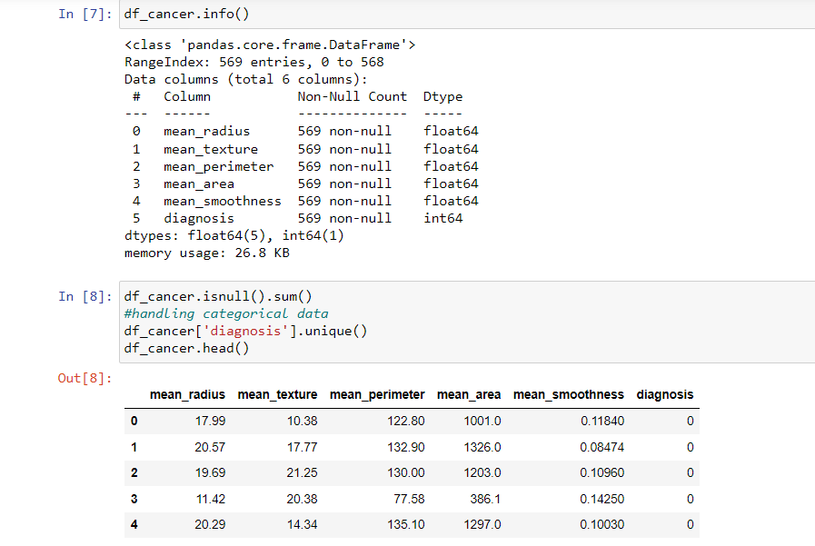

Slide 11
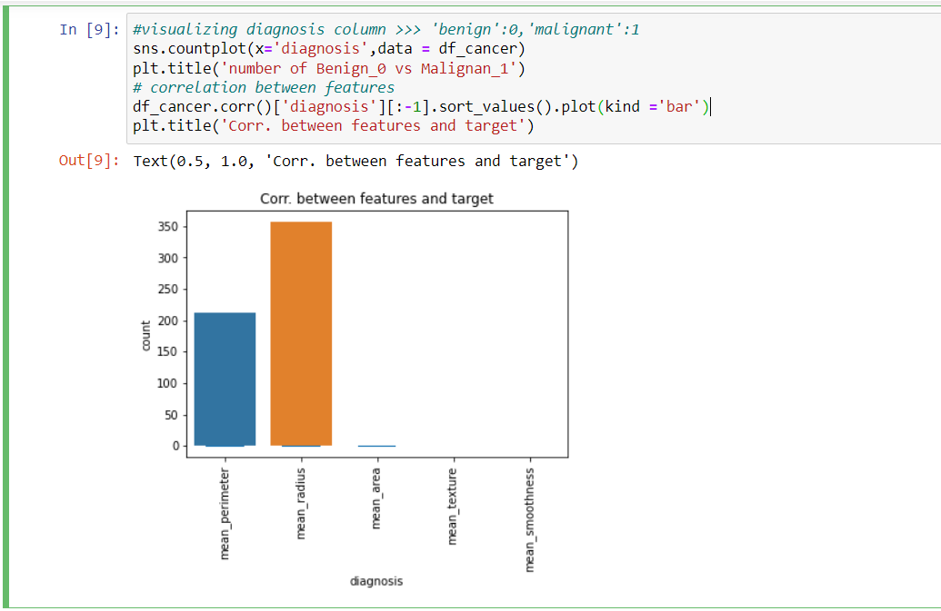

Slide 12
We had 143 women in our test set.
Out of 55 women predicted to not have breast cancer, two were classified as not having when actually they had (type one error).
Out of 88 women predicted to have breast cancer, 14 were classified as having breast cancer while they did not (type two error)

Slide 13
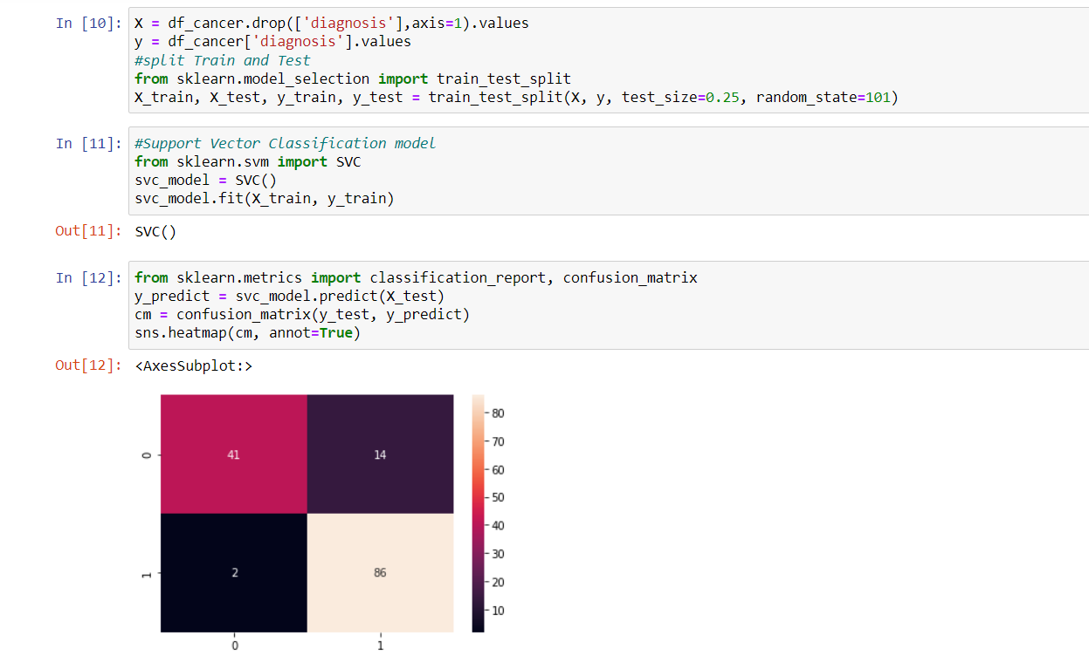

Slide 14
